Slide 1
6th FITCE-Technology Forum
Chania, 3 June 22
mmWave FWA a game changer for broadband
Michalis Sidiropoulos, Technology Expert
Intracom S.A. Telecom Solutions | 19.7 km Markopoulou Ave., GR 19002 | t: +30 2106671000 | f: +30 2106671001 | www.intracom-telecom.com

Slide 2
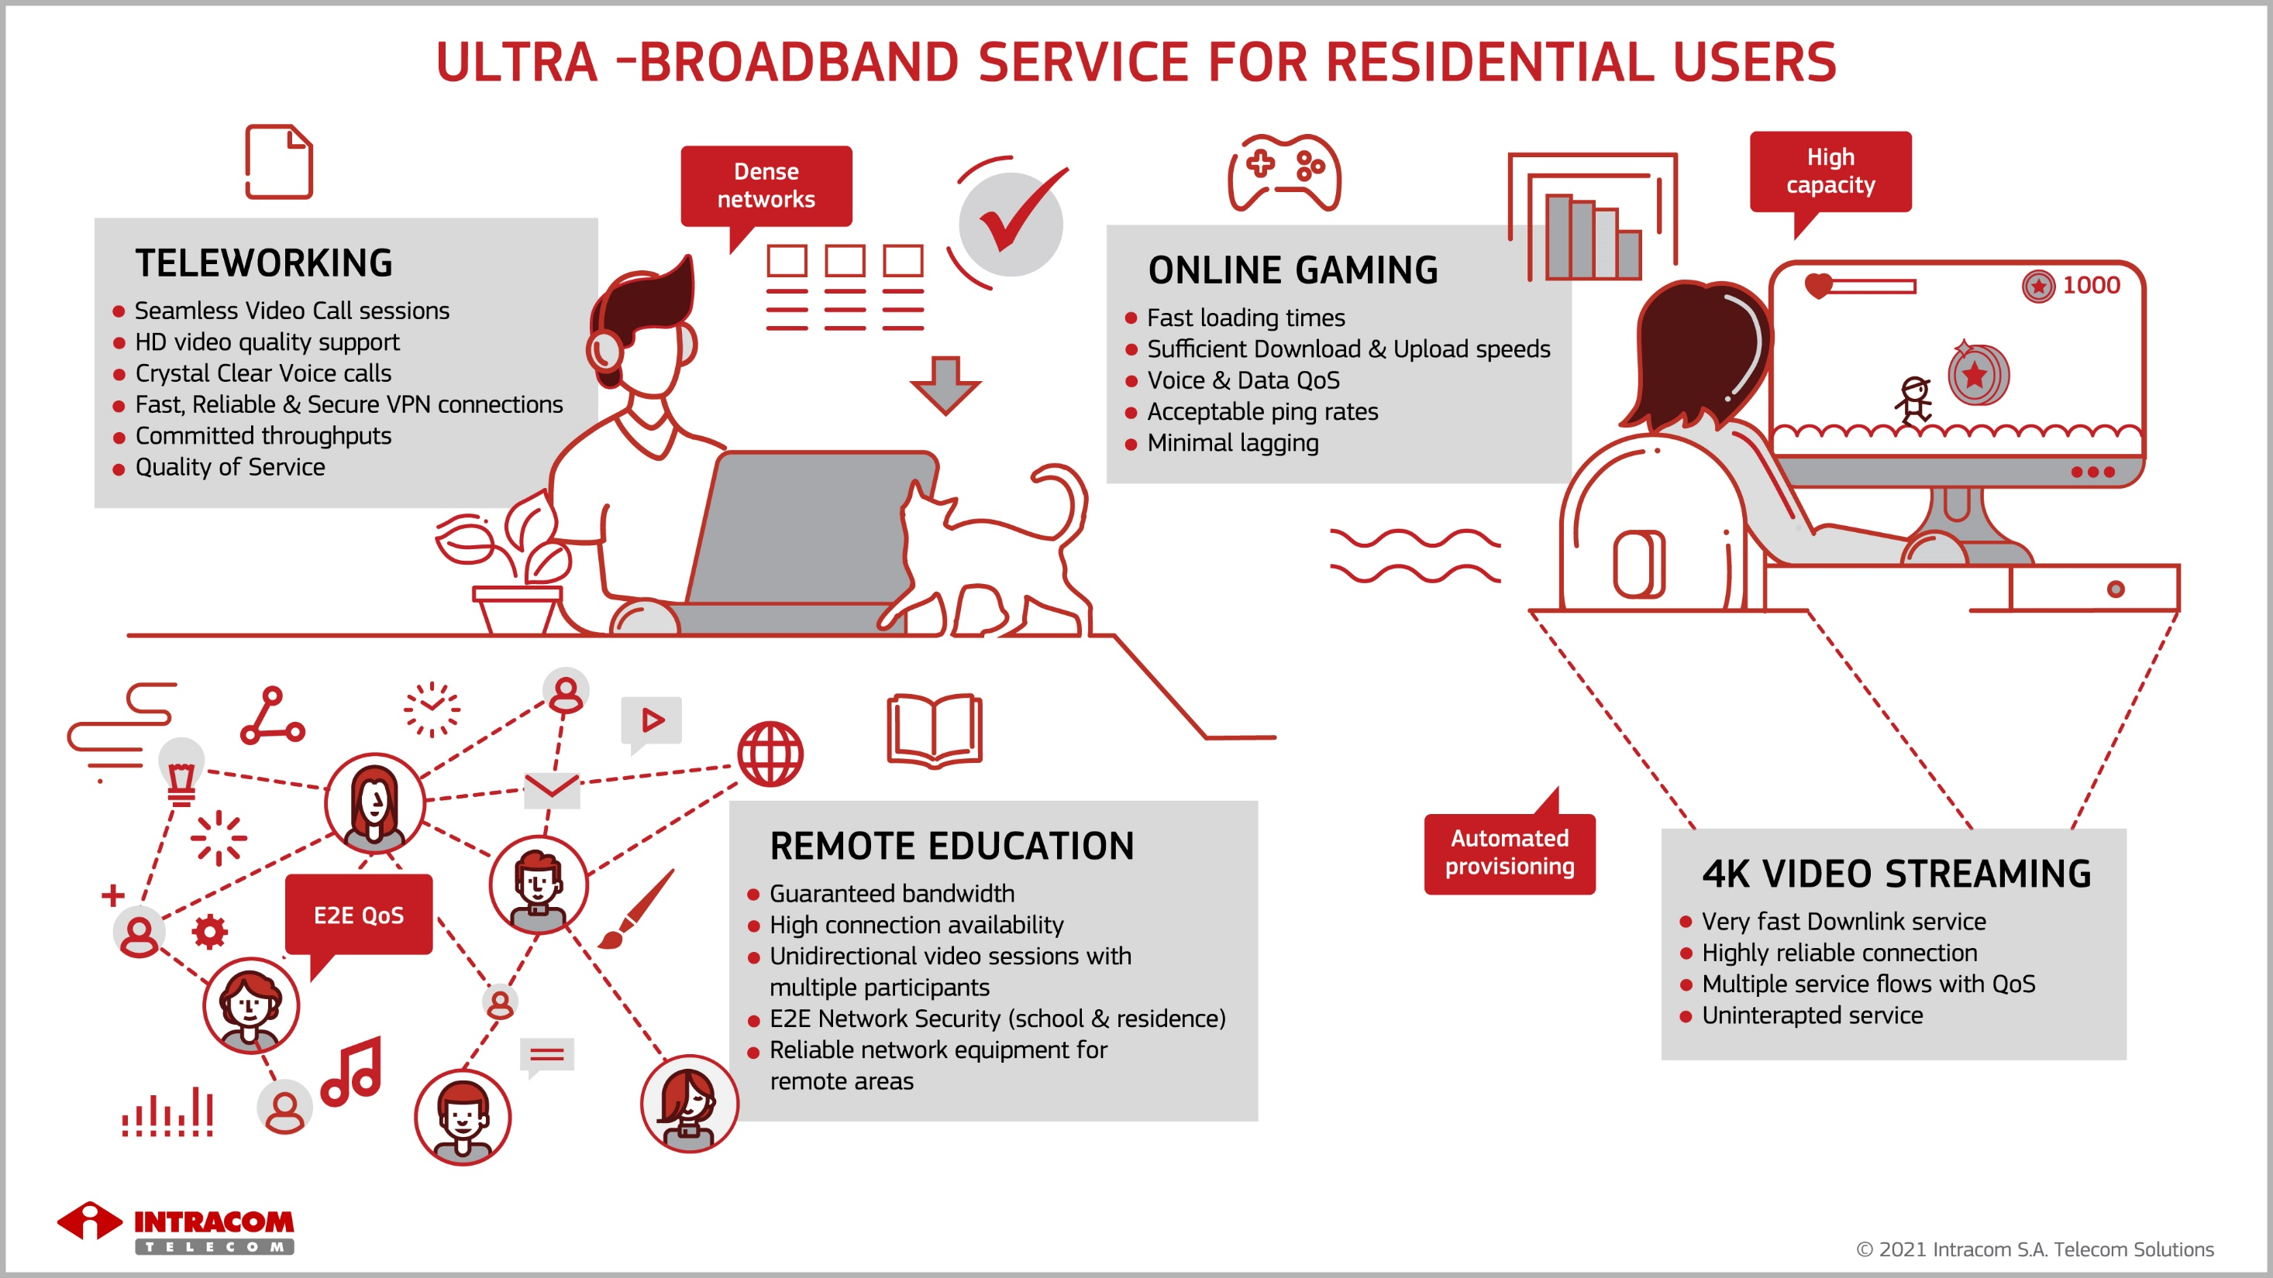

Slide 3
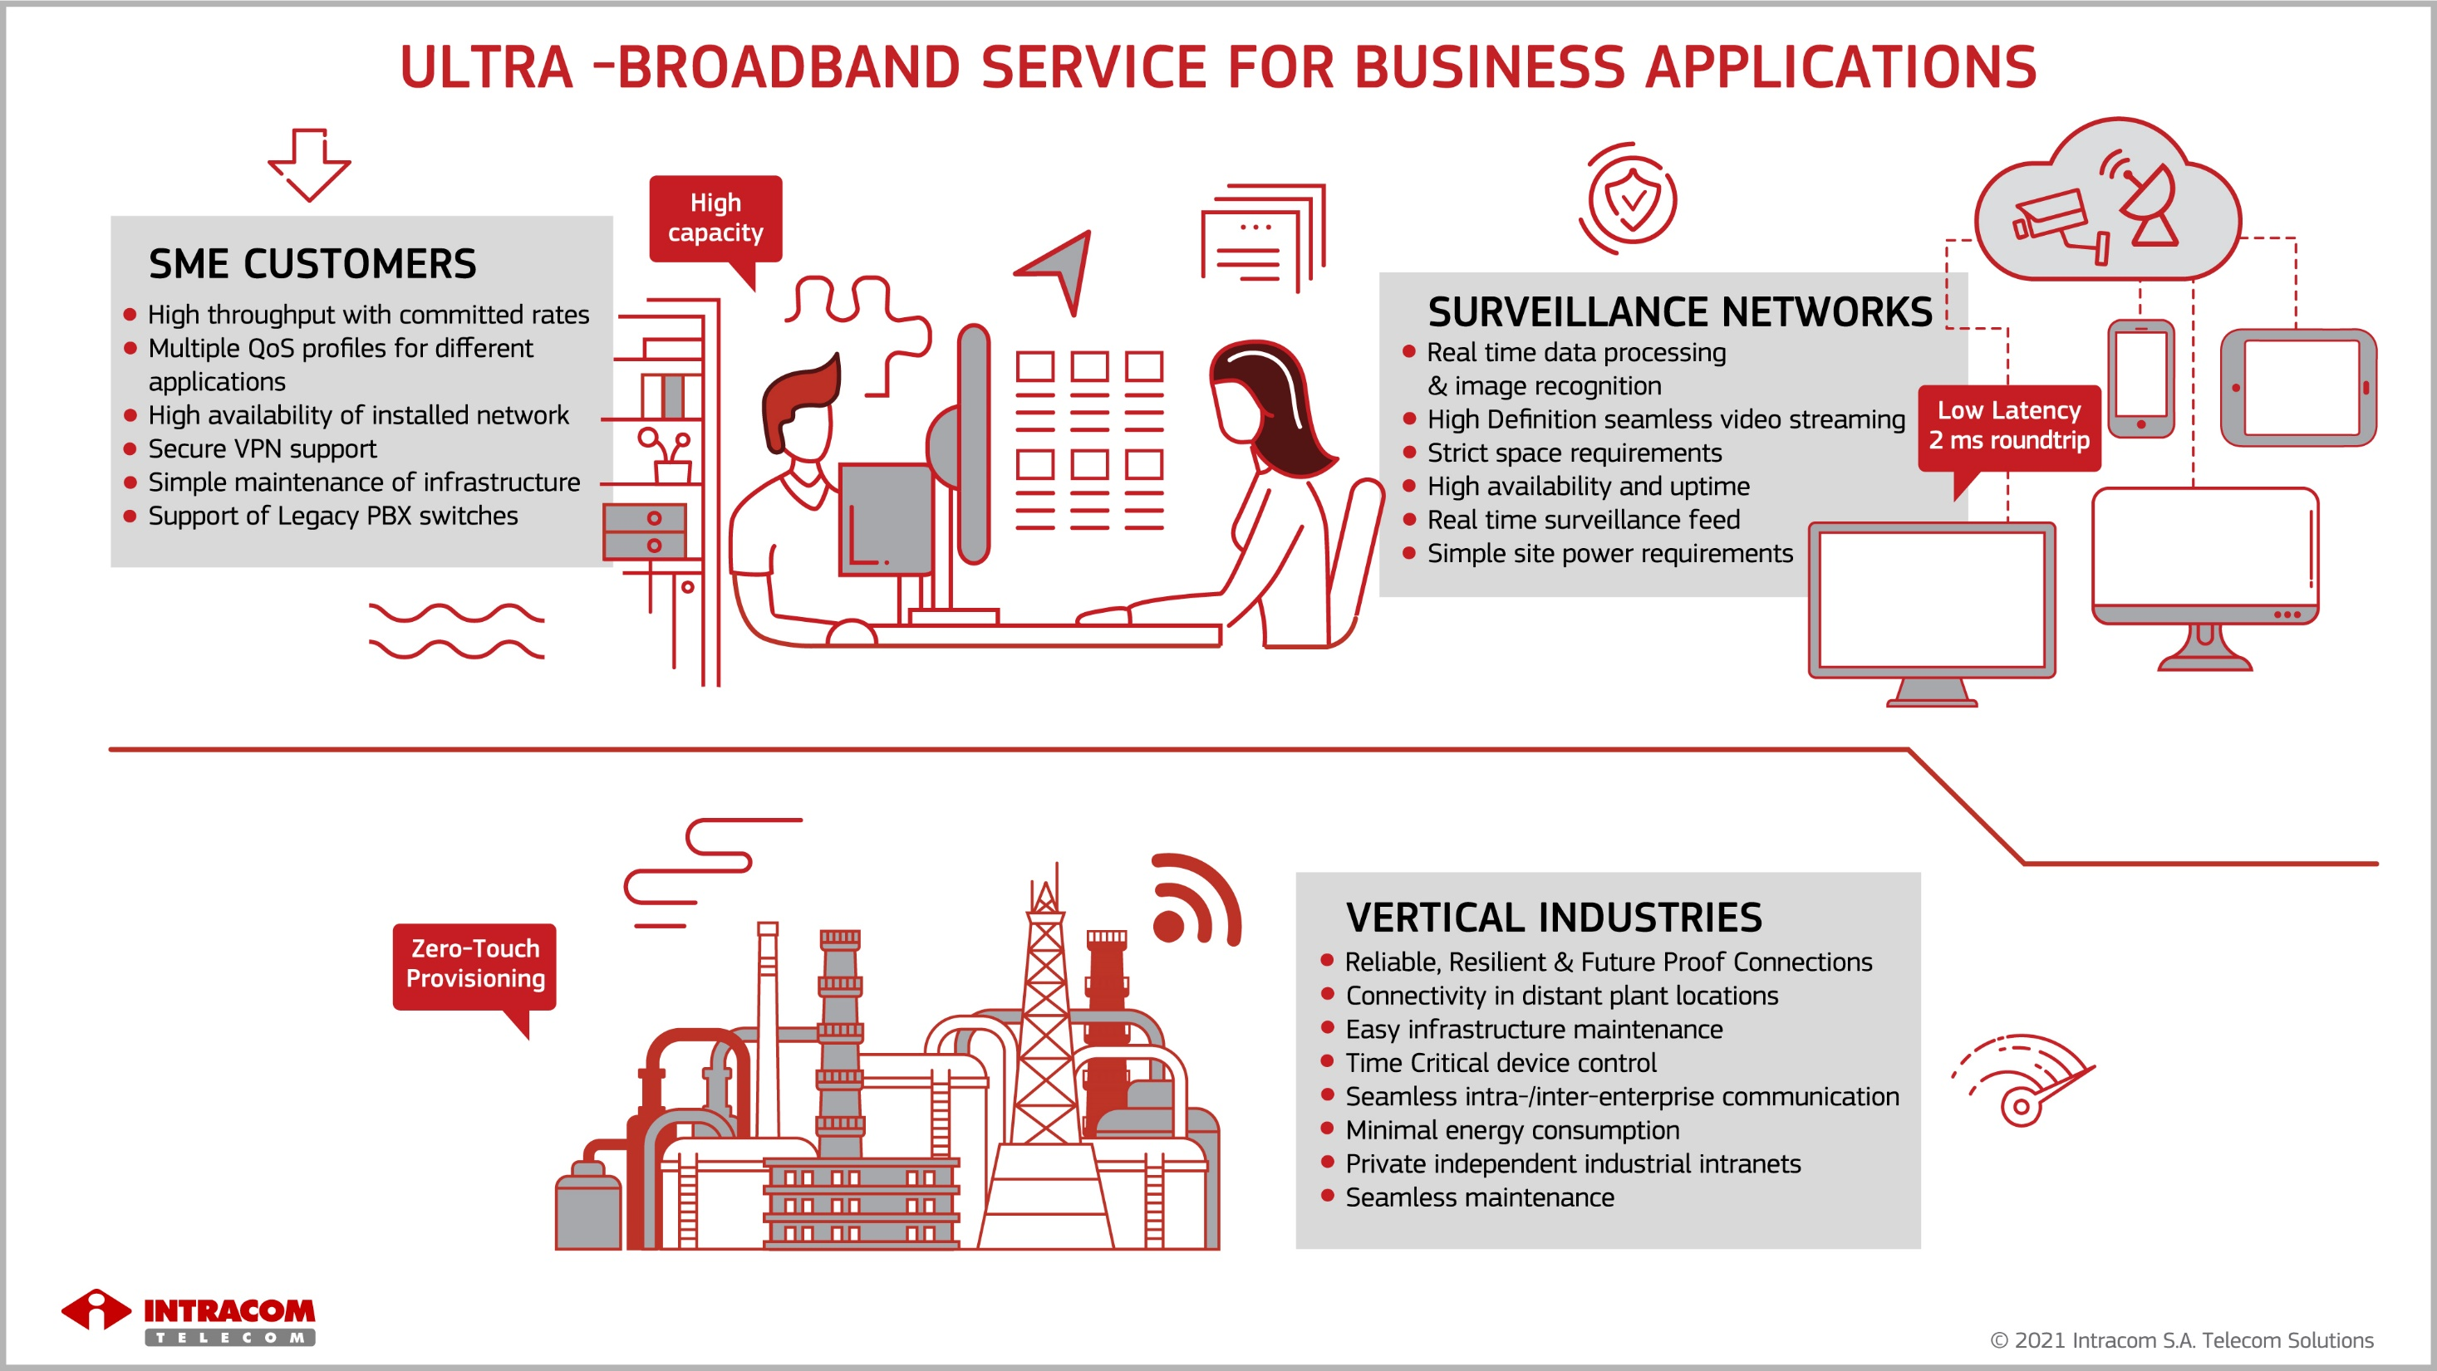

Slide 4
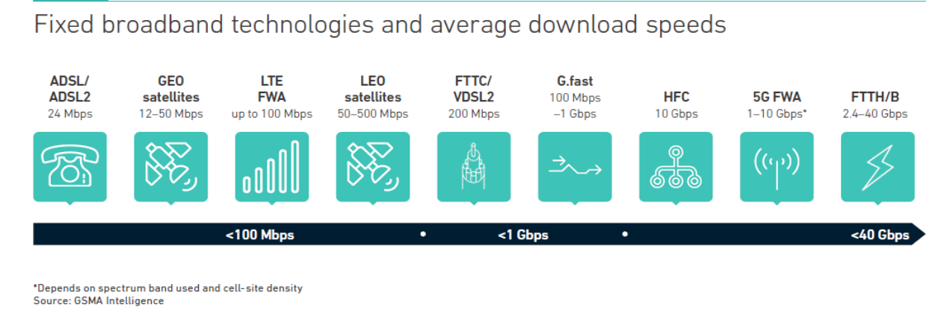
Fixed Broadband Toolbox
Copper is gradually decommissioned – e.g Norway is decommissioning all xDSL
Wireline solutions found in Urban environments
There is still a large underserved/unserved market

Slide 5

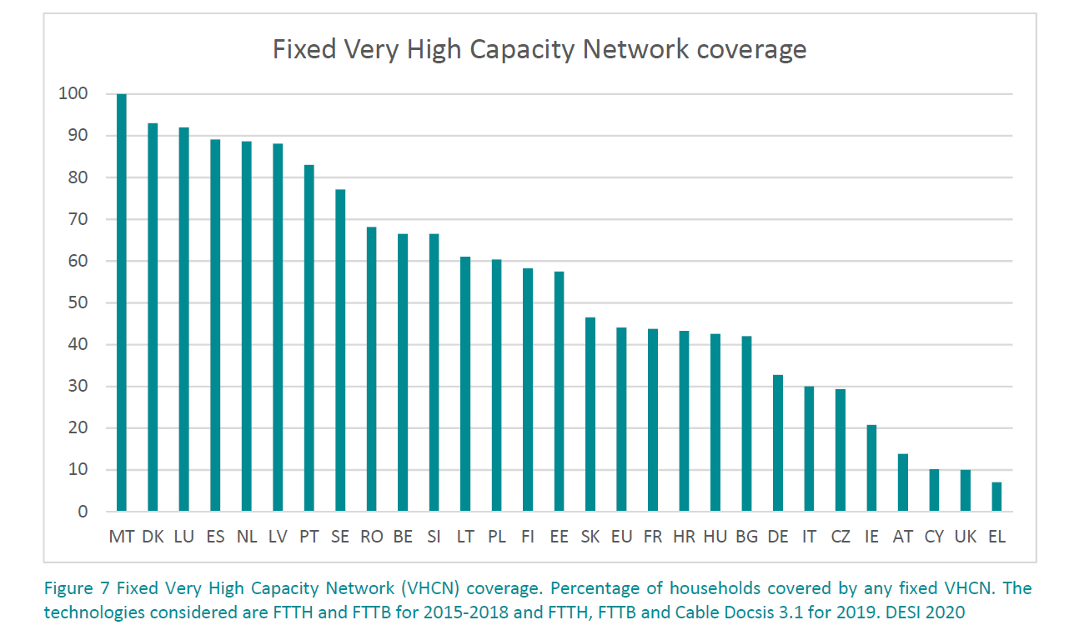
VHCN Households coverage in Europe
VHCN ( >100Mbps) Households Fiber&Cable Coverage is at 44%
Plenty of room for FWA growth

Slide 6
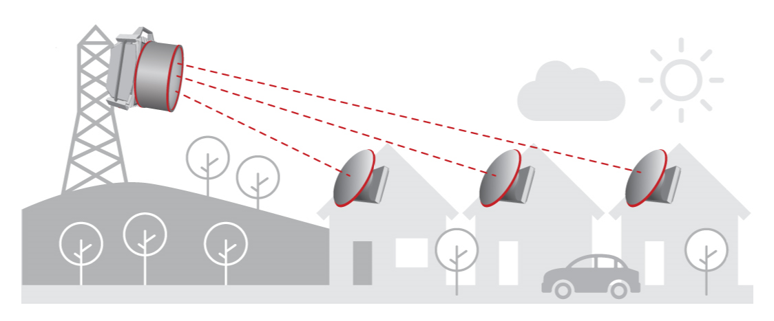
What drives FWA?
“Connecting the unconnected” ~ 800Million Homes worldwide
More Spectrum bandwidth becomes available (mmWave bands)

Slide 7
FWA versus FTTH
Very High
Very High
High
High
Moderate
Moderate
Low
Low
Very Low
Very Low
FWA
Gigabit experience at the End User
smart antennas,
additional spectrum, BS / TS replacement
FTTH
Multiple Gbps DL per OLT
Upgrade OLT, ONT line-cards
Hub & Terminals Installation
Failure points only BS or TS
Failure points: OLT, ONT, Splitters, Fiber Loss/Damage
Digging, OLT, ONT, Splitters, Fiber
FWA
Fast rollout, simple installation
Cost Effective Radios, inexpensive deployment process, build as you grow
FTTH
Involves digging & trenching
Expensive civil works + Electronics + obtaining trenching permits
High Cost-To-Pass/ Cost-To-Connect
Low Cost-To-Pass/ Cost-To-Connect
Low CAPEX/OPEX, faster Time To Market
High CAPEX/OPEX longer Time To Market

Slide 8
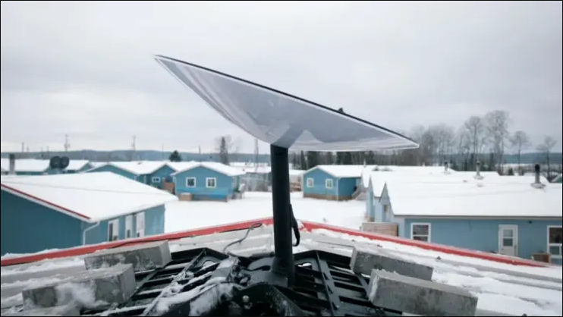
FWA versus LEO Satellite Broadband
LEO Satellite broadband targets ~5% of the population, in isolated areas
Low PIR data rates 100Mbps DL ,difficult to upgrade.
High latency values compared to the 5G vision
High CPE cost and monthly subscription fee.

Slide 9
FWA Frequency Bands
C Band
3.50-4.20 GHz
Long range
5 GHz
5.10-5.85 GHz
Unlicensed
mmW 24 / 26 / 28 / 31 / 32 / 39 GHz
Licensed
60 GHz
Several GHz
Licensed
Low capacity
few 100s of MHz
few 100s of MHz
Long range
Low capacity
Several GHz
Long range
High capacity
Very short range
High capacity
Unlicensed
Expensive
Interference free
Free
Prone to interference
Interference free
Inexpensive
Free
mitigated Interference

Slide 10




Synergistic use cases in mmWave bands – The need for coexistence
mmWave licensed frequency bands
3GPP standardized
eMBB
uRLLC
Purpose-built
FWA
FWA
IOT
Surveillance
MOBILE
FIXED
Technology Neutrality (3GPP or purpose built) drives innovation

Slide 11



Capacity
(Speed)
5G Fixed
(mm-Wave)
Intracom Telecom FWA ecosystem
1 Gbps
Purpose-built
802.11-based
(mm-Wave)
802.11-based
100’s Mbps
LTE
(2-5 GHz)
3GPP-based
802.11-based
(2-5 GHz)
10’s Mbps
Urban
Suburban
Rural
Range

Slide 12
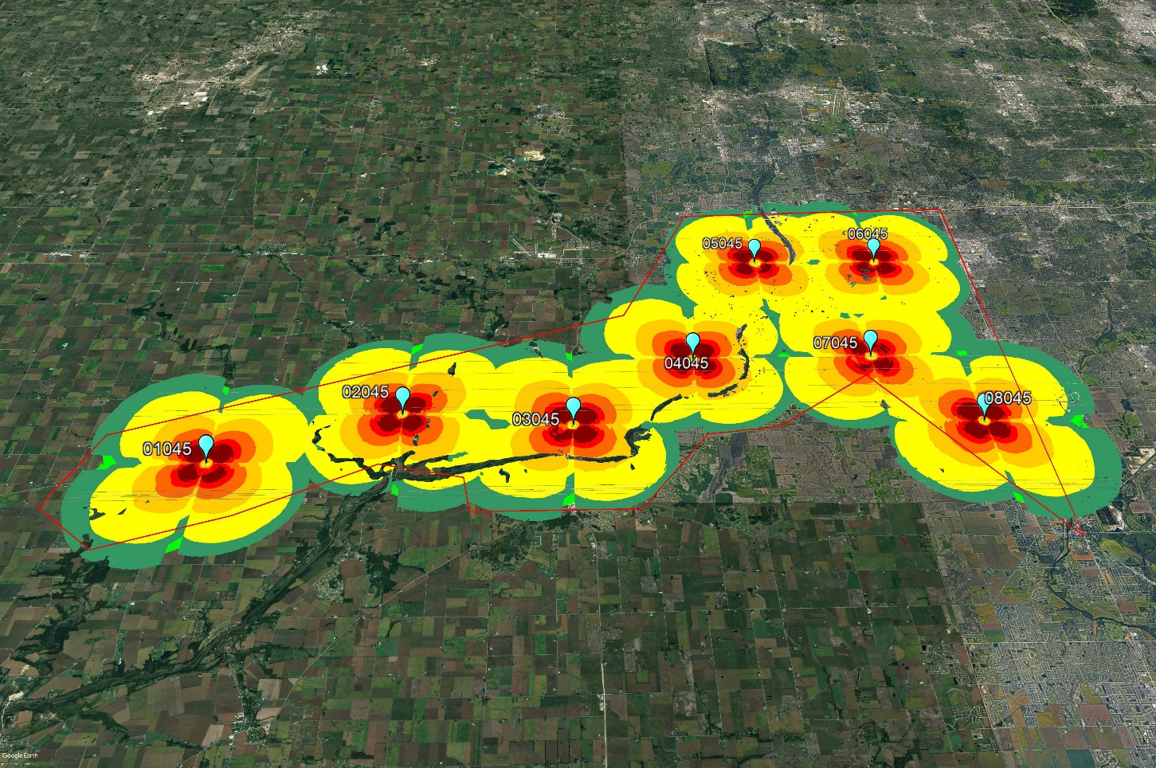
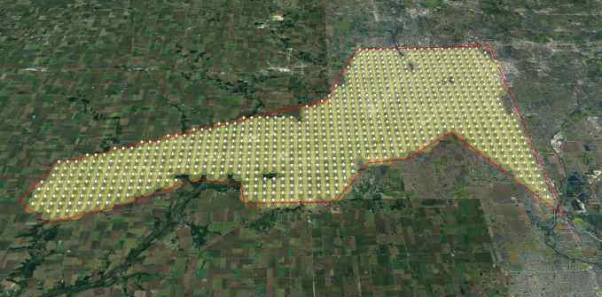

FWA extended range drives dramatically TCO down
Long reach
mmW FWA
Chicago, sub-urban
Commercial 5G –FWA
860 Base Stations, 500m radius
Covered Area 460 Km²
Purpose-built
8 Base Stations, 6Km radius

Slide 13
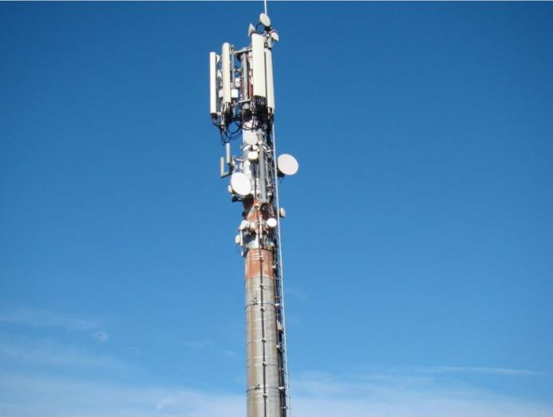
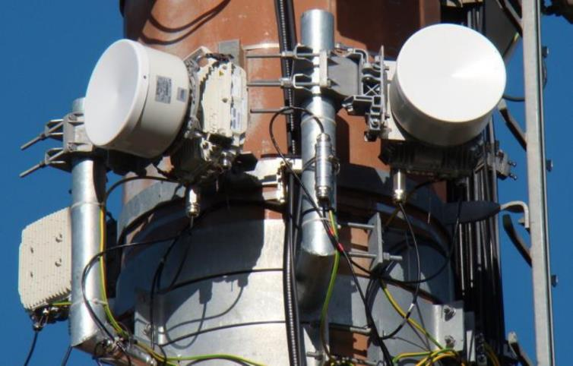
FWA reuses infrastructure

Slide 14
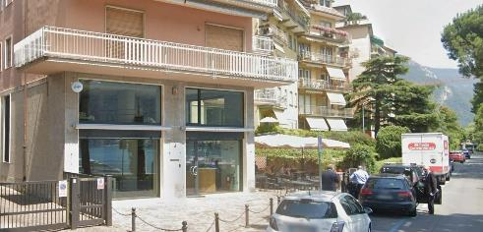
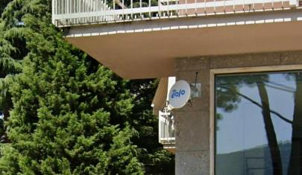
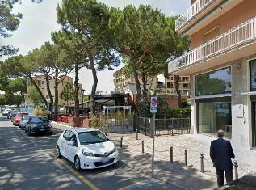
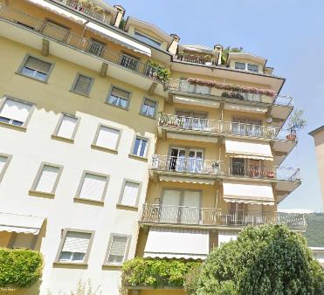

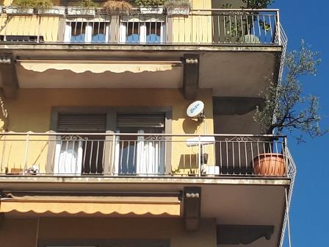
Easy Fast FWA installation

Slide 15
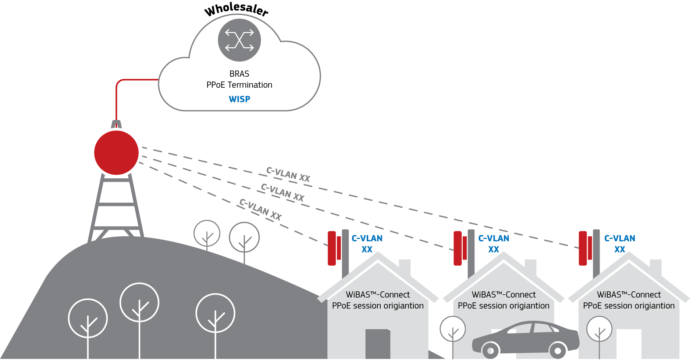
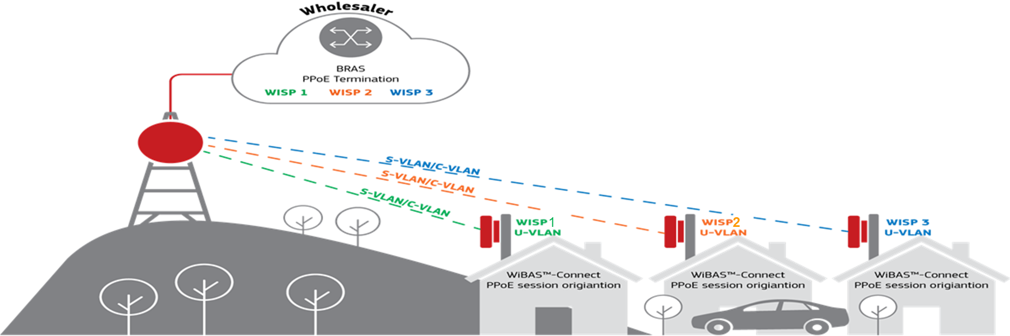
Flexible Business model support
Direct Model
Single WISP
Different Services are offered with different C-VLANs
QoS enabled services
CIR/PIR per service (Voice, Data, Video)
Wholesale Model
Multiple WISPs
S-VLAN defines Operator/Service
C-VLAN defines Customer
2:1 translation
  S-VLAN/C-VLAN → U-VLAN
QoS enabled services (CIR/PIR)

Slide 16
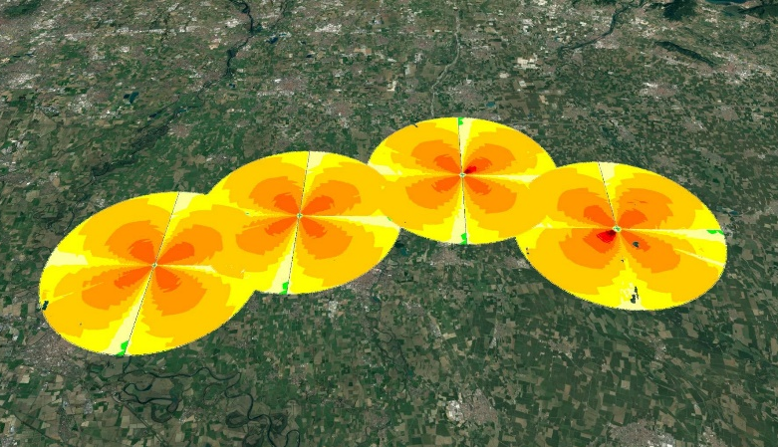

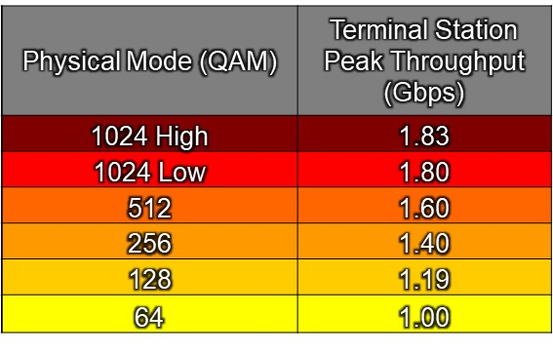
FWA Case Study, Cremona suburbs, Italy
mmWave FWA, Downlink coverage
6 km
1Gbps Downlink end user Speed @64QAM
1Gbps Downlink end user Speed@ 6Km!
https://www.intracom-telecom.com/en/news/articles/articles2022/june_1_2022.htm

Slide 17
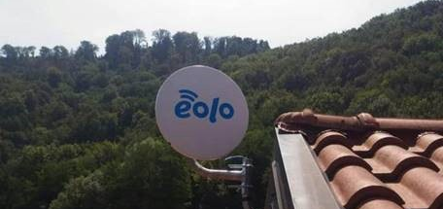
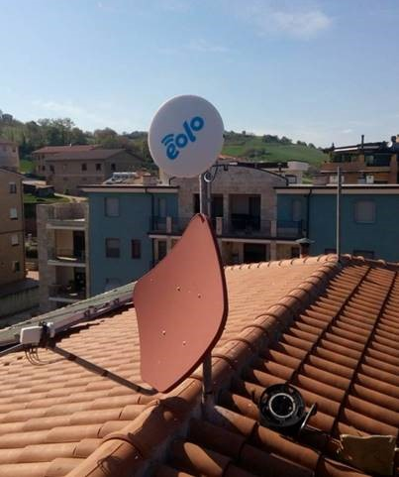

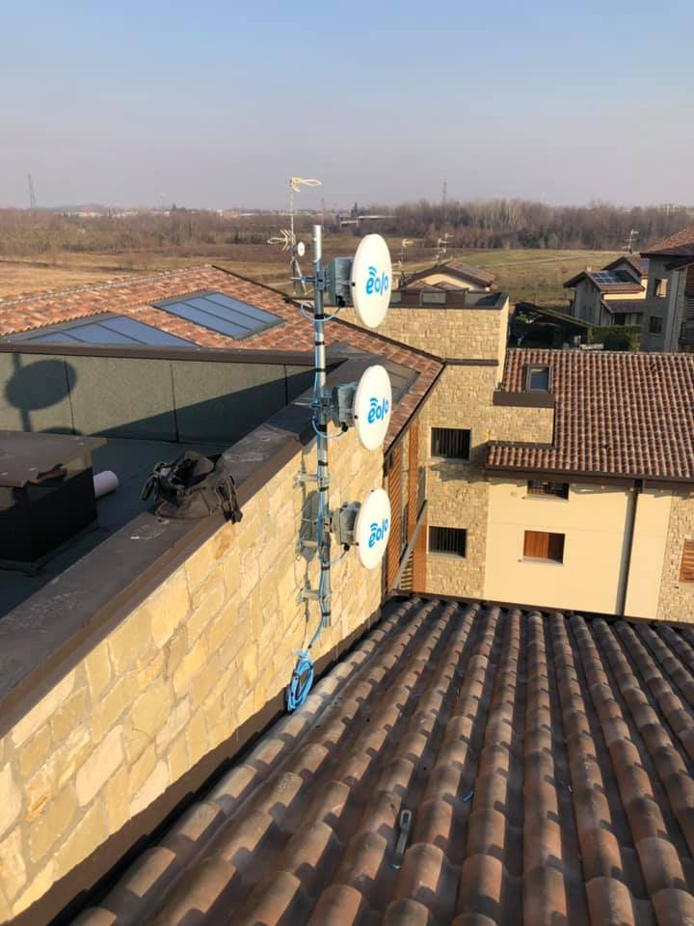
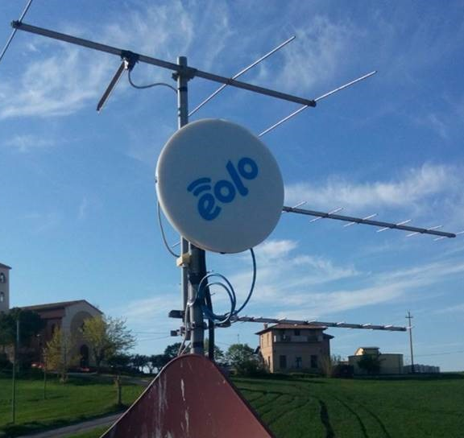
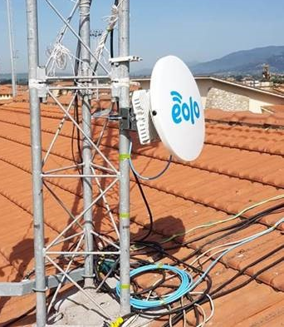

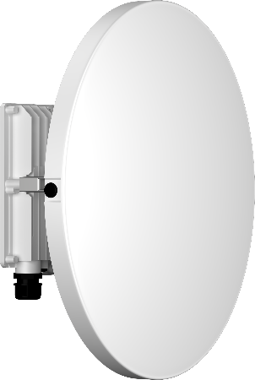

WiBAS™ purpose-built FWA, delivering excellence in EOLO
Italy
The largest long-range mmWave FWA network worldwide
Licensed 28GHz spectrum (also available at 26GHz)
Ultra broadband, fibre-like services with QoS
Extended Coverage, addressing rural, semi-rural & sub-urban
Dense network of several 100s of terminals per Base Station
Massive nationwide network rollout

Slide 18
mmWave FWA, wrap-up
A Win-Win approach for Operators and Consumers - available NOW
Outdoor CPEs guarantee QoS and enhance End User experience
Its advanced system design, enables dense networks.
Fast Time To Market solution, with low TCO
mmWave Spectrum offers mind blowing Gigabit data rates, with Ultra low latency
Long range (up to 11Km) LoS FWA, connects everyone, everywhere

Slide 19
For more information, visit
www.intracom-telecom.com

Slide 20
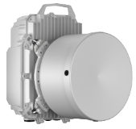
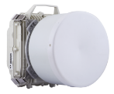








WiBAS™ PtMP - FDD product line
FDD 28 GHz – 56/112 MHz Ch. BW
Base Station
FDD 10.5 / 26 / 28 GHz - 56 MHz Ch. BW
FDD 10.5 / 26 / 28 GHz – 56 MHz Ch. BW
24.25-29.50GHz – (56/112 MHz FDD)
Terminal
Stations

Slide 21
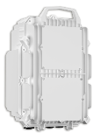



WiBAS™ PtMP TDD product line
TDD 24.25-29.50 GHz - 40 / 50 / 56 / 75 / 100 / 112 MHz Ch. BW
Base Station
FDD / TDD 24.25-29.50GHz – (40 / 50 / 56 / 75 / 100 / 112 MHz TDD)
Terminal
Station

